Slide 1
M. Azeem qureshi

Slide 2
Outline
Executive Summary
Introduction
Methodology
Results
Conclusion
Appendix

Slide 3
Executive Summary
SpaceX advertises Falcon 9 rocket launches at $62 million. Other providers' rocket launches cost upwards of
$165 million.
SpaceX's cost savings are mainly due to reusing the first stage.
The project’s objective is to derive a model that predicts if the Falcon 9 first stage will land successfully.

Slide 4
Executive Summary - Methodology
Data understanding and collection
  Identify and gather relevant data sources for SpaceX launches. Ensure the foundation of the analysis is based on accurate and complete data.
Data preparation and wrangling
  Clean and preprocess the data to ensure quality and usability for analysis..
Exploratory data analysis (EDA) and Interactive visual analytics
  Gain insights and understand data patterns, distributions and relationships.
  Enable dynamic interaction with data visualizations to foster deeper insights.
Predictive analysis using classification models
  Develop models to predict future Falcon 9 landing outcomes

Slide 5
Executive Summary - Results
The available data shows that the success rate for the last year of observations reached a range of more than 80% which explains the cost savings through reuse of the Falcon 9 first stage.
We can see a clear positive trend in the success rate of first stage landings for the Falcon 9 over the years. Technological advancements like Grid Fins or Landing Legs paired with growing experience in operations support the trend and indicate sustained future cost advantages for SpaceX.
With the derived Decision Tree model, we can predict future landing outcomes with an accuracy of more than 80%.
The model should be continuously updated to take future outcomes and changes in technology into consideration.

Slide 6
Introduction
Project background and context
Questions to be addressed

Slide 7
Project background and Context
SpaceX manufactures and operates space rockets and aims for reusability of the first stage of the rocket as competitive advantage.
SpaceX advertises Falcon 9 rocket launches at $62 million. Other providers' rocket launches cost upwards of $165 million.
SpaceX's cost savings are mainly due to reusing the first stage.
Determining and understanding the influence factors for the first stage landing success can help determine launch costs. This information could aid alternate companies in bidding against SpaceX.
The project’s objective is to derive a model that predicts if the Falcon 9 first stage will land successfully.

Slide 8
Questions to be addressed
Can we see a success rate of landings for the Falcon 9 rocket Stage 1 that allows reuse and explains the cost advantage for SpaceX?
How did the success rate of landings develop over time and is a trend visible that indicates sustained future cost advantages for SpaceX?
What accuracy can we deliver with a ML model to predict the success of future landings of Falcon 9 first stage after launch?

Slide 9
Methodology section 1

Slide 10
Methodology
Data understanding and collection
Data preparation and wrangling
Exploratory data analysis (EDA)
Interactive visual analytics
Predictive analysis using classification models
Presentation of Results

Slide 11
Data understanding and collection
We used two primary data sources:
  The open available SpaceX API
  Wikipedia as trusted open information source via Web Scraping
The SpaceX API offers access to historic data for rocket launches and landings since 2010. It is implemented as REST web services that can be accessed with an URL. The successful response contains the data in JSON format.
Wikipedia holds verified additional information for the SpaceX launches that can be extracted by Web scraping and joined with the SpaceX API data.

Slide 12
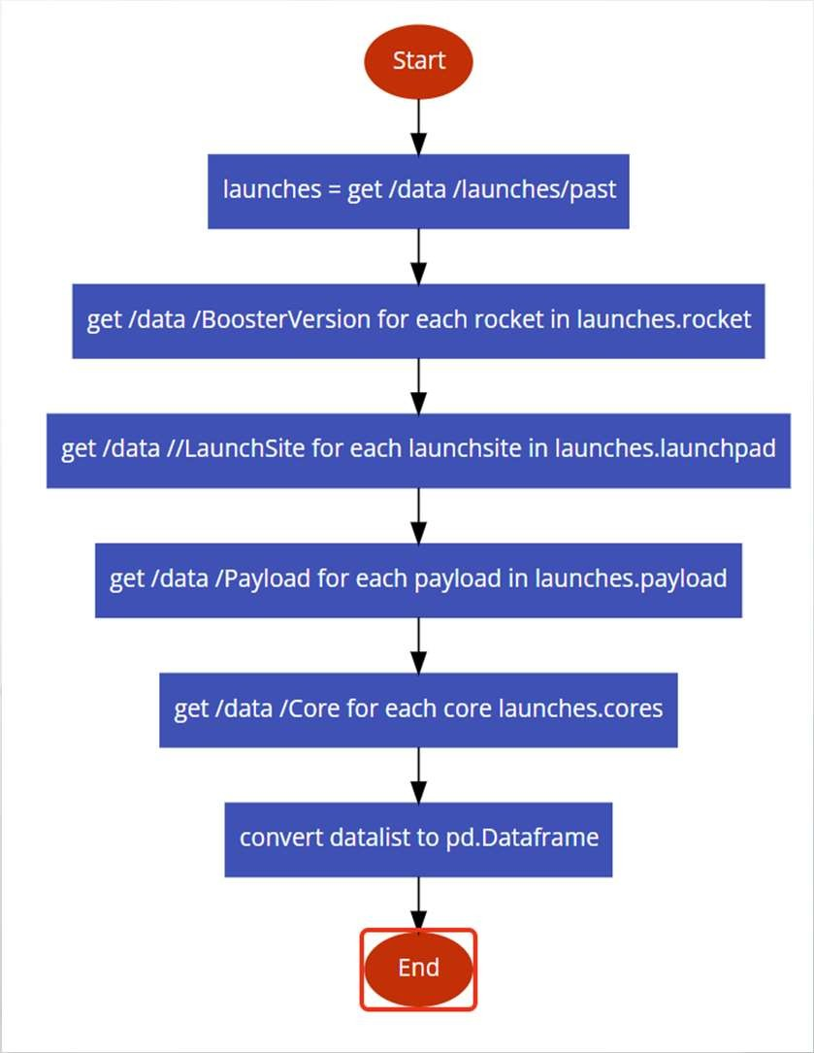
Data collection – SpaceX API
The SpaceX API can be accessed by the base URL https://api.spacexdata.com/v4/
There are different datasets available. For our purpose we used
the following five:
  /launches/ to get the list of all past launches
  /rockets/ for the booster name
  /launchpad/ for the launch site information
  /payload/ for mass of payload and orbit
  /cores/ for outcome and type of the landing, number of flights with that core, gridfins use, whether the core is reused, whether legs or landing pad were used, the block version of cores, number of reuse, and serial of the core.

Slide 13
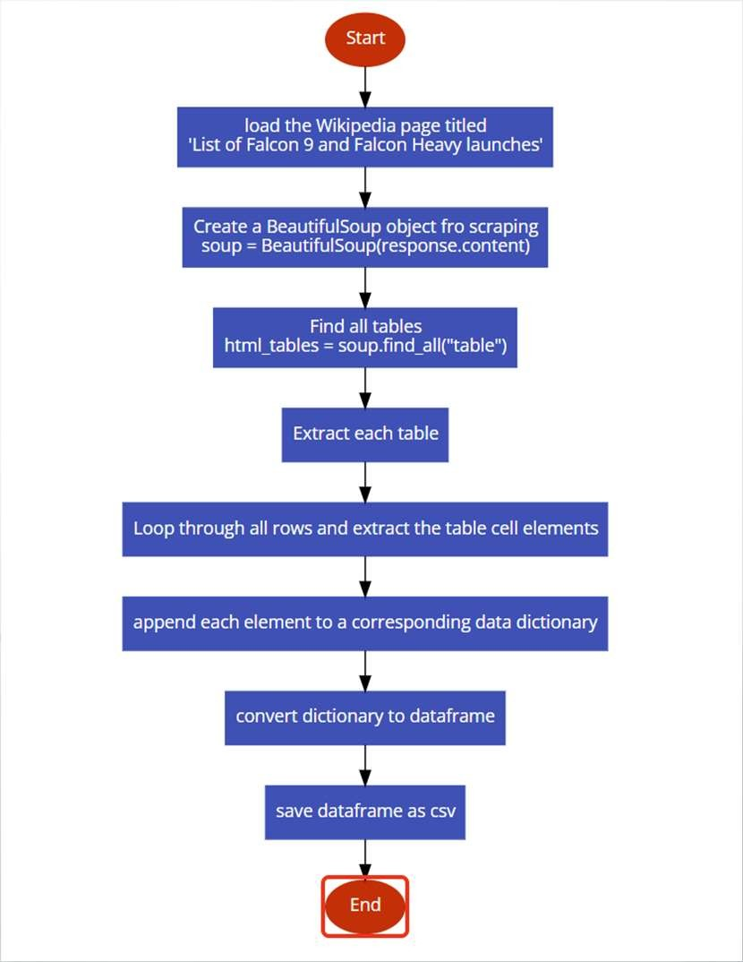
Data collection – Web Scraping
Use of Web scraping to collect Falcon 9 historical launch records from a Wikipedia page titled `List of Falcon 9 and Falcon Heavy launches`
Web scrap Falcon 9 launch records with
`BeautifulSoup`:
  Extract a Falcon 9 launch records HTML table from Wikipedia
  Parse the table and convert it into a Pandas data frame

Slide 14
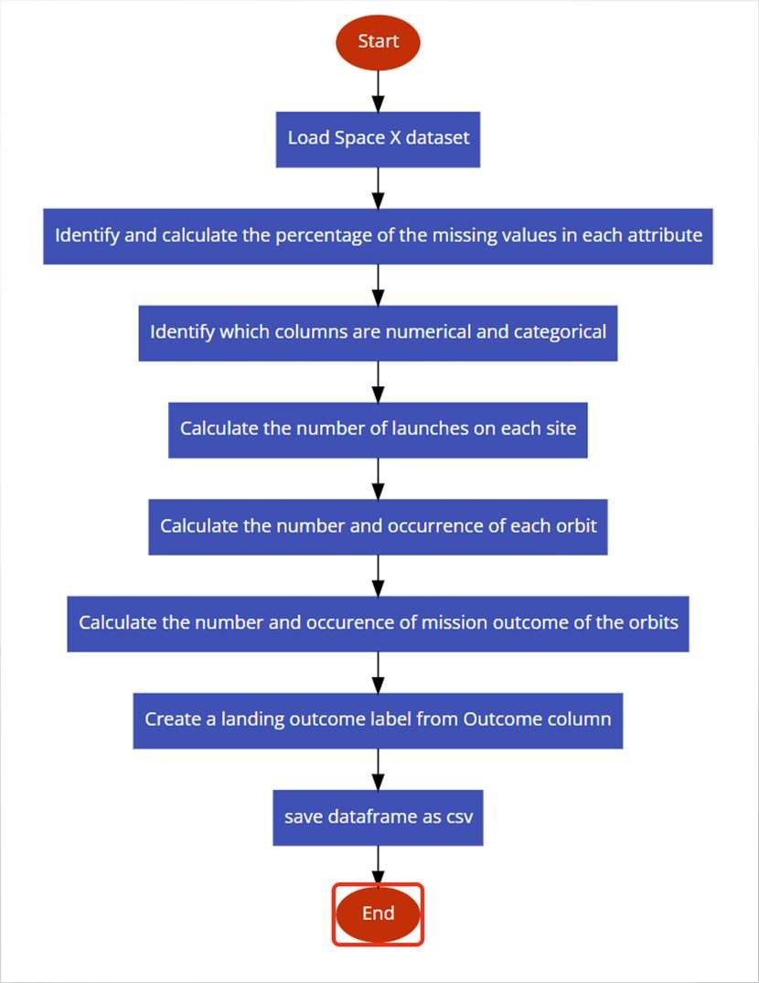
Data preparation and wrangling
Data wrangling was performed mainly for the SpaceX API data set. The steps are illustrated in the flowchart and included:
  Identify and calculate the percentage of the missing values in each attribute
  Identify which columns are numerical and categorical
  Data aggregation and value counts
  Creation of label to describe success or failure of the Falcon9 first stage landing

Slide 15
EDA with Data Visualization
The following charts were prepared to explore the data and its relationships or dependencies
  Payload Mass over the continuous Flightnumber at different dates as Scatterplot with indication of Success or Failure
  Launch Site over the continuous Flightnumber at different dates as Scatterplot with indication of Success or Failure
  Launch Site over Payload Mass as Scatterplot with indication of Success or Failure
  Success Rate per Orbit type as Barplot
  Orbit over the continuous Flightnumber at different dates as Scatterplot with indication of Success or Failure
  Orbit over Payload Mass as Scatterplot with indication of Success or Failure
  Success Rate for each year as Lineplot to visualize a trend

Slide 16
EDA with SQL
The following SQL queries were performed to explore the data and its relationships or dependencies further
  Query the names of launch sites in the space mission
  Query the average payload for Falcon9 v1.1
  List the date of the first successful landing
  List the Booster Versions with Successful landing on a drone ship
  List the total number of of success and failures
  List the Booster Versions that carried the maximum payload
  List month, Launch Site and Booster Version for failed landings for 2015 on drone ships
  Rank the landing outcomes between 2010-06-04 and 2017-03-20

Slide 17
Interactive Visualization with Folium
To explore the locations of the different launch sites we created Folium maps and included the following objects
  Circles to mark the four Launch Sites
  Markers in a MarkerCluster for each successful or failed landing on the different Launch Sites
  Lines and labels to indicate the distances of a selected Launch Site to the nearest coastline, highway, railway and closest city

Slide 18
Interactive Dashboard with Plotly Dash
A Dashboard with Plotly Dash has been implemented to perform interactive visual analytics on SpaceX launch data in real-time. Two Graphs are visualized:
  A Pie Chart shows the success rates depending on the selected sites
  A scatter plot shows the correlation between payload and success with a variation in the Booster Version Category, indicated by different colors. The underlying data can be filtered by site selection and payload range.
The interactive dashboard filter for the data are:
  A dropdown box to select a specific launch site or all sites
  A range slider to define the payload range.
The plots allow to understand the dependencies between launch site and success, as well as the impact of payload on the success for different Booster Versions.

Slide 19
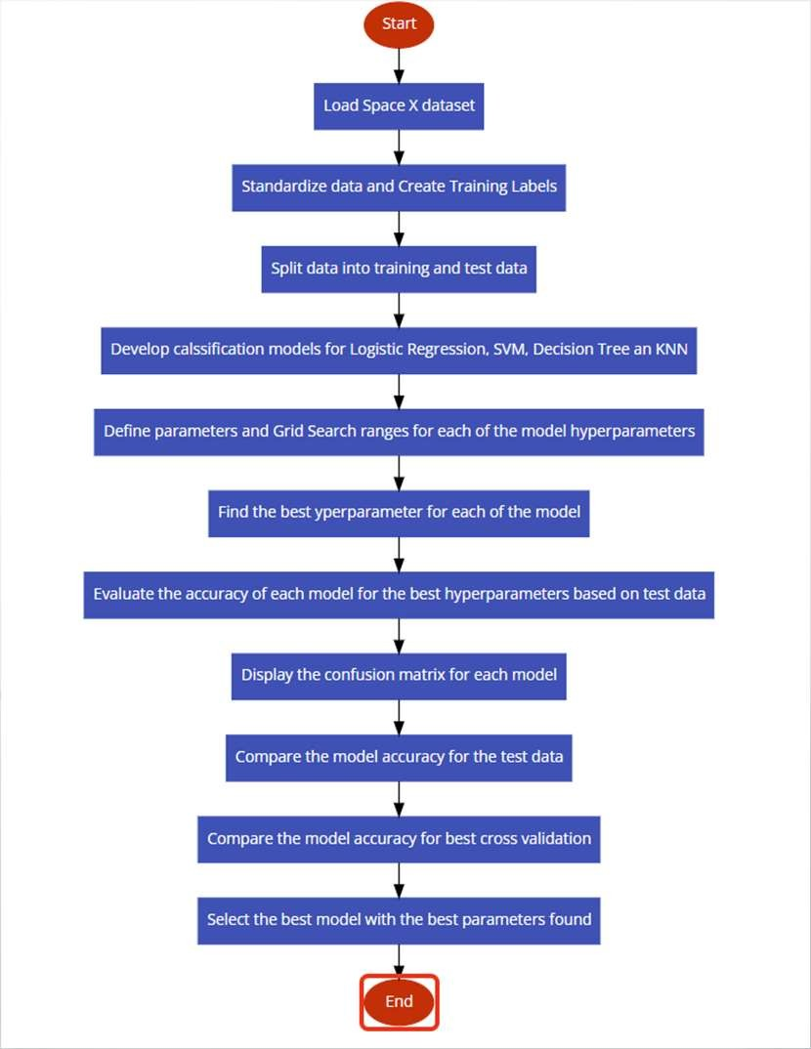
Predictive analysis using classification models
To predictively analyze the SpaceX first stage landing success, we preprocessed the data, split the data into training and test data and developed four classification models:
  A Logistic Regression Model,
  a Support Vector Machine Model,
  a Decision Tree Model and
  a K Nearest Neighbor Model
Each of the models were trained with the training data and tested with the test data set.
The models were analyzed for accuracy by calculating the accuracy score and plotting the confusion matrix.

Slide 20
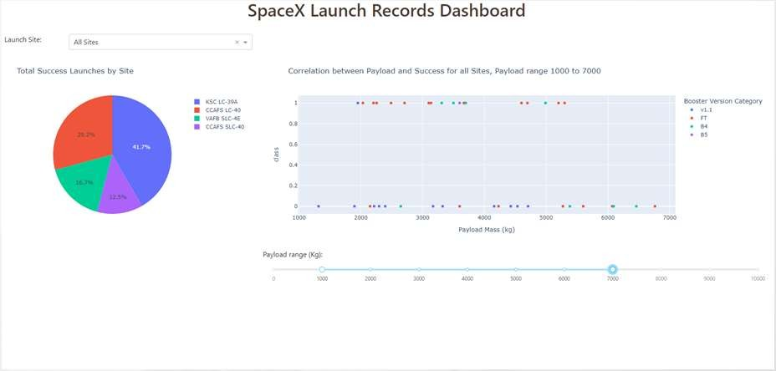
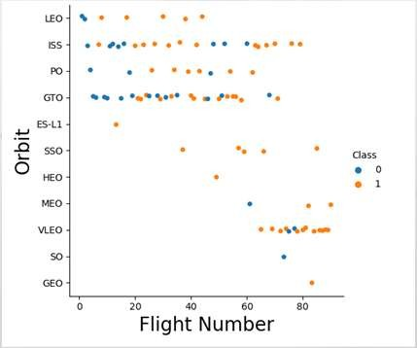
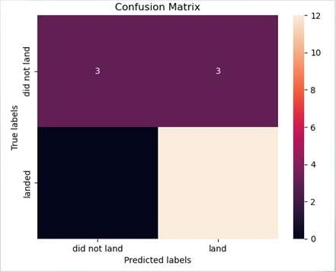
Presentation of Results
The Results of the project will be presented in the final section and include:
  Graphs and Plots created during Explorative Data Analysis,
  Screenshots from the developed Interactive Plotly Dash App,
  Accuracy tables and Confusion Matrix for the classification models

Slide 21
Insight drawn from eda
Section 2

Slide 22
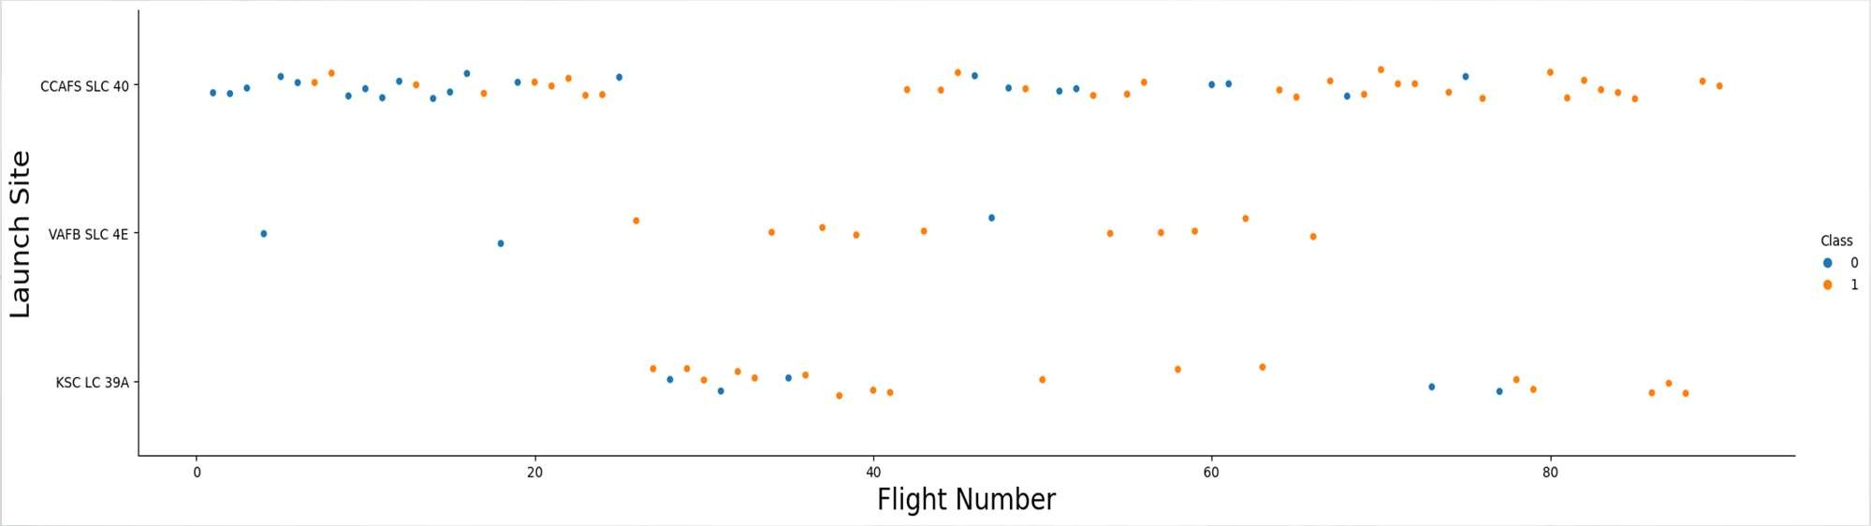
EDA – Flight Number vs Launch Site
No clear pattern that differentiates the different Launch Sites
All Launch Sites show improvement in successful landing over time
Launch Site CCAFS SLC 40 is the most frequently used Launch Site
Launch Site VAFB SLC 4E is not as often used especially lately
Launch Site KSC LC 39 A was introduced at a later stage

Slide 23
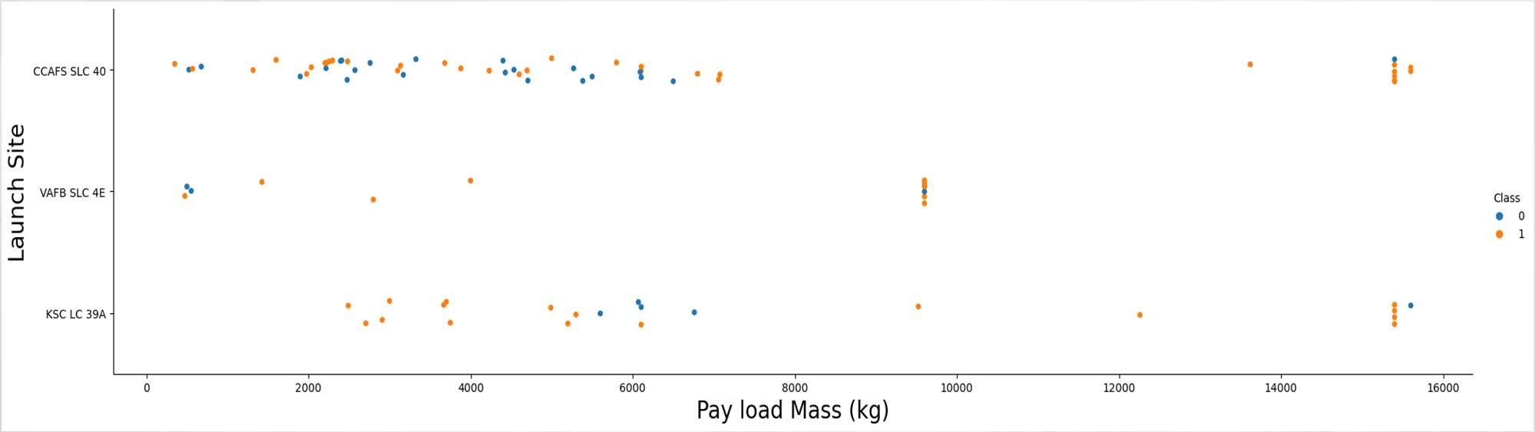
EDA – Payload vs Launch Site
Launch Site CCAFS SLC 40 was used for the whole range of payload and shows also success for high payloads
Launch Site VAFB SLC 4E was not used extensively and did not launch rockets with high payload
Launch Site KSC LC 39 A also show a wide range of payloads and successful launches for high payloads

Slide 24
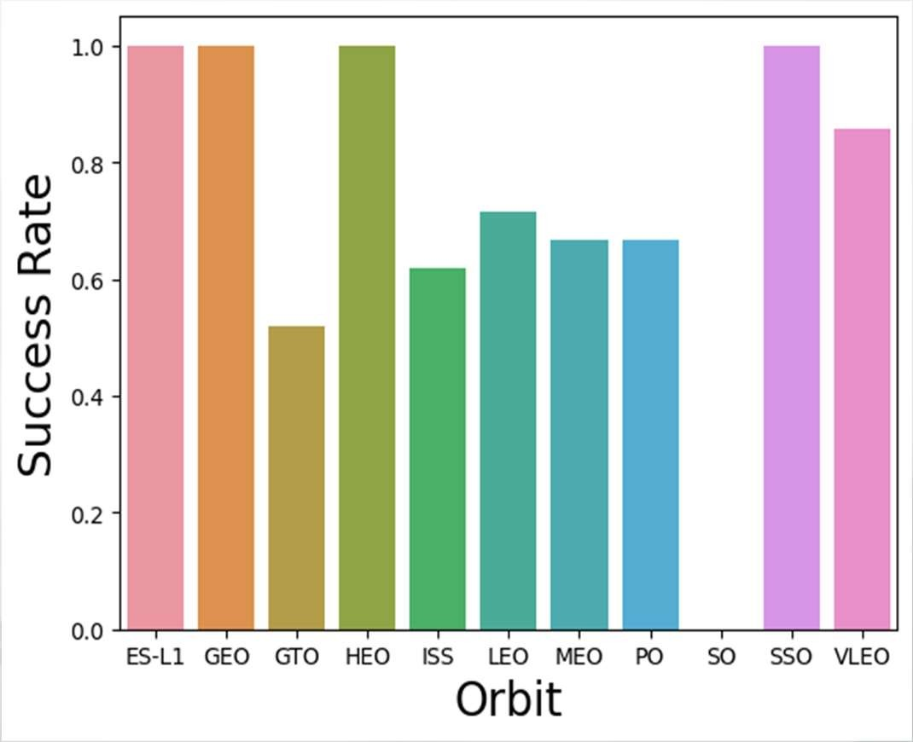
EDA - Success Rate vs Orbit
A barchart of the Orbits and their Success Rates for landing shows that there are some Orbit with perfect success.
ES-L1, GEO, HEO and SSO have a 100% success rate
VLEO is also showing better performance at 80%
All otherOrbits are in the range of 50-70% with GTO at 50% and LEO at 70%
The success rate does not take the number of launches into account! We used a second plot to understand the success of the Launch sites better on the next slide.

Slide 25
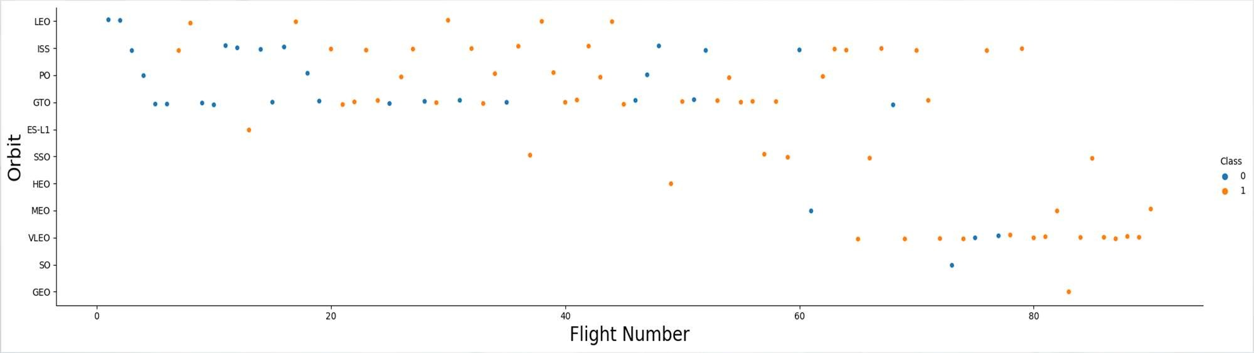
EDA – Orbit vs Flight Number
The chart clarifies the results from the success rate
The Orbits with 100% success were not targeted very often, some of them only once
It looks like the VLEO orbit with its pretty high success rate was used only in the newer history, which can also explain better performance due to improved technology

Slide 26
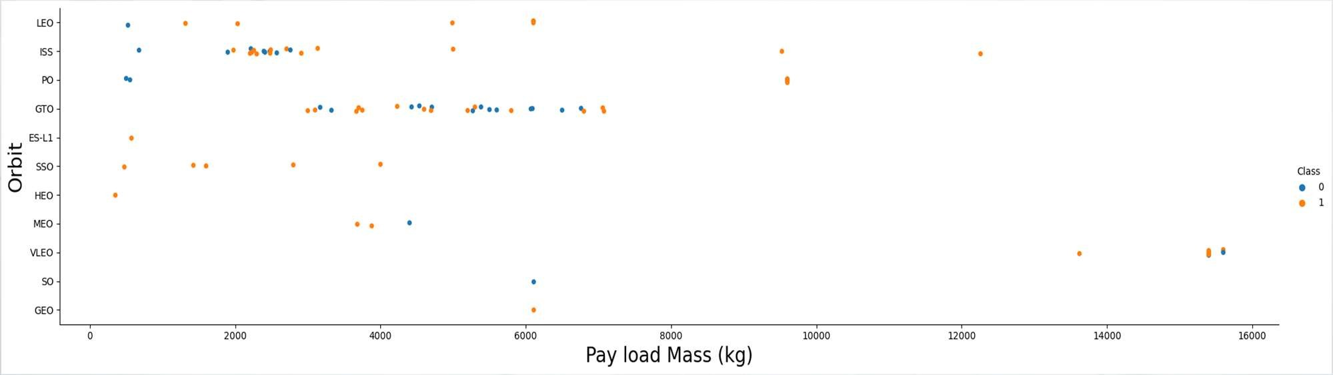
EDA – Orbit vs Payload
The chart shows that the heaviest payloads were exclusively sent to Orbit VLEO
It shows also that only big payloads were sent to VLEO
ISS shows that a wide range of payloads was sent including some heavier payloads above 10000kg
Orbit PO was targeted with either very low or very high payload, The high payloads were successful, the light ones failed.

Slide 27
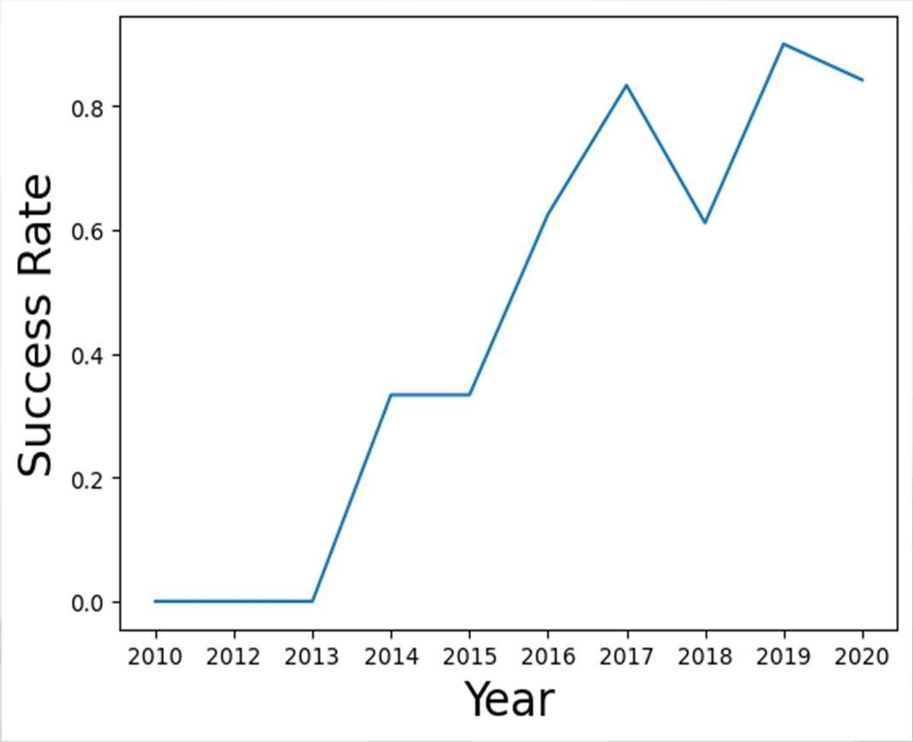
EDA – Launch Success Yearly Trend
We can see a clear trend of improving success rates over the years, even though it wasn’t continuous (2018 and 2020 show reduced success rates compared to the previous year)
The initial years were not successful at all
2016 was the first year that shows a success rate of more than 50%
In general it looks like a good learning curve driven by gained insights and improved technology

Slide 28
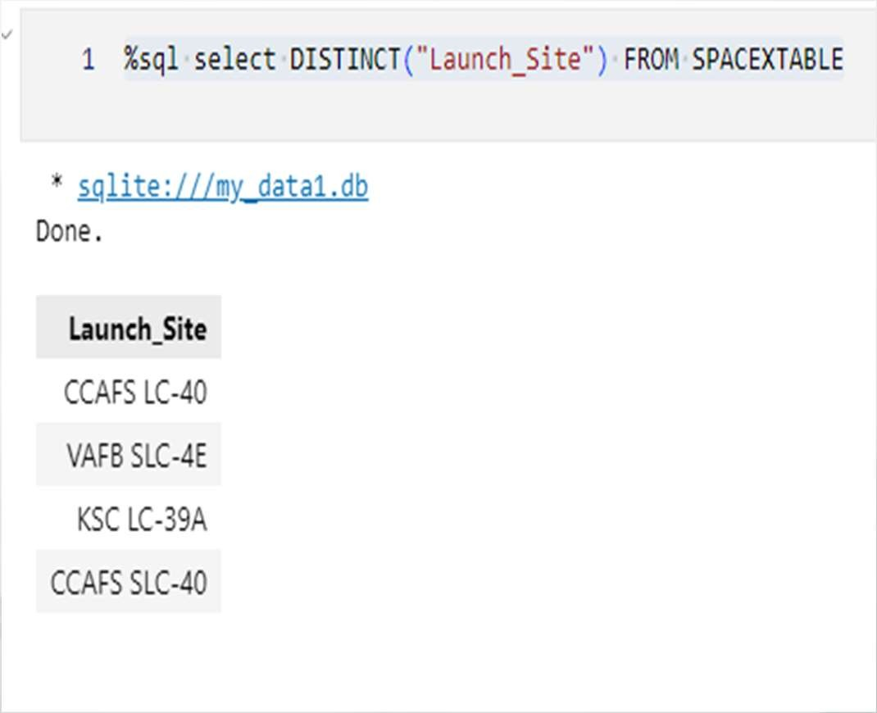
EDA- SQL Launch Site Names
On the right you can see the query to find the names of the Launch Sites

Slide 29
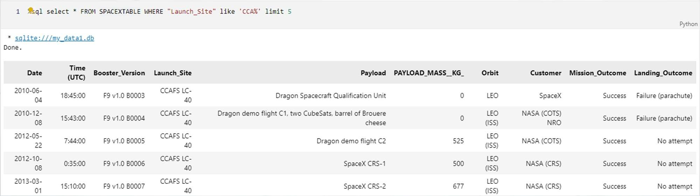
EDA – SQL 5 Launch Site Names begin with CCA
Above 5 records of Launch Site names starting with CCA are shown

Slide 30
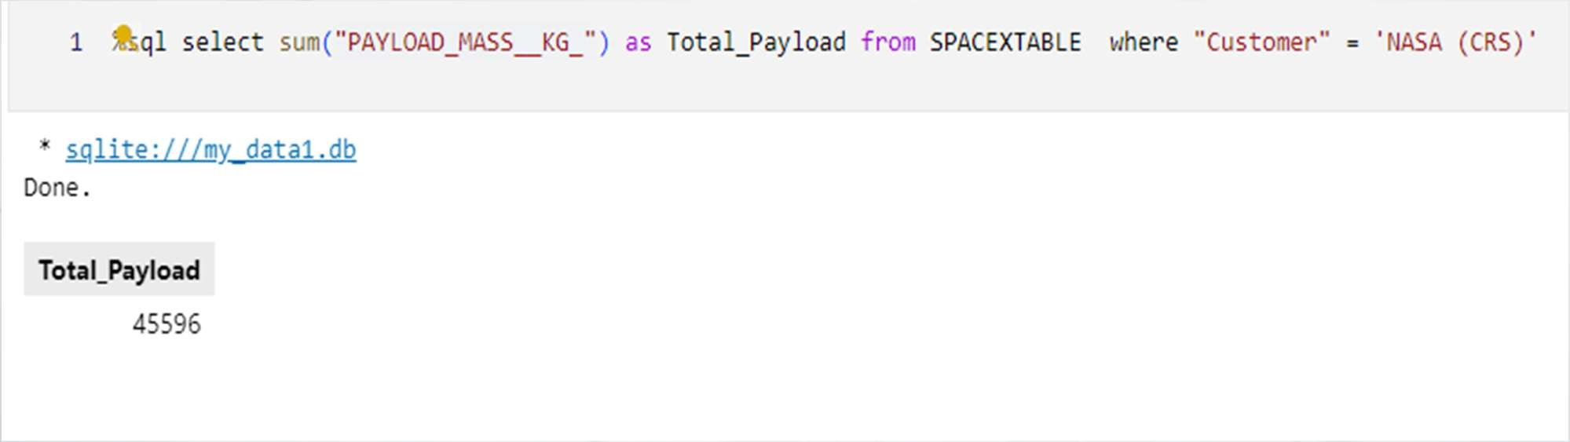
EDA – SQL Total Payload mass
The total payload mass for NASA as customer is 45,596 kg

Slide 31
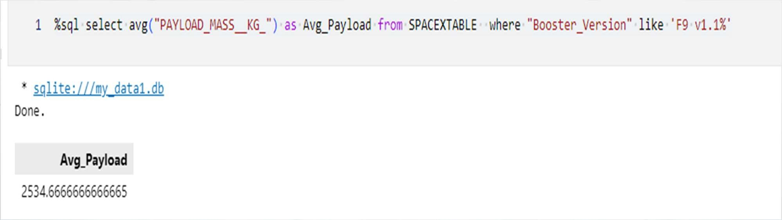
EDA – SQL Average Payload Mass for F9 v1.1
The average payload mass for Booster Version F9 v1.1 is 2,534.7 kg

Slide 32
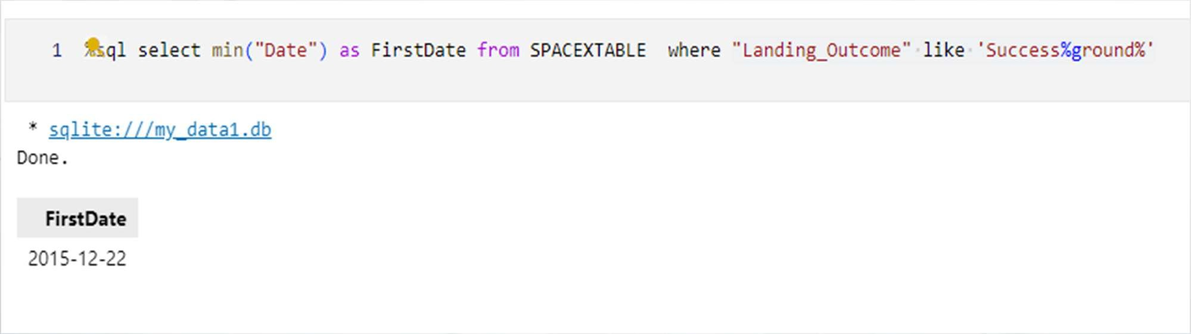
EDA – SQL First Successful Ground Landing Date
The first successful ground landing was achieved on December 22nd 2015

Slide 33
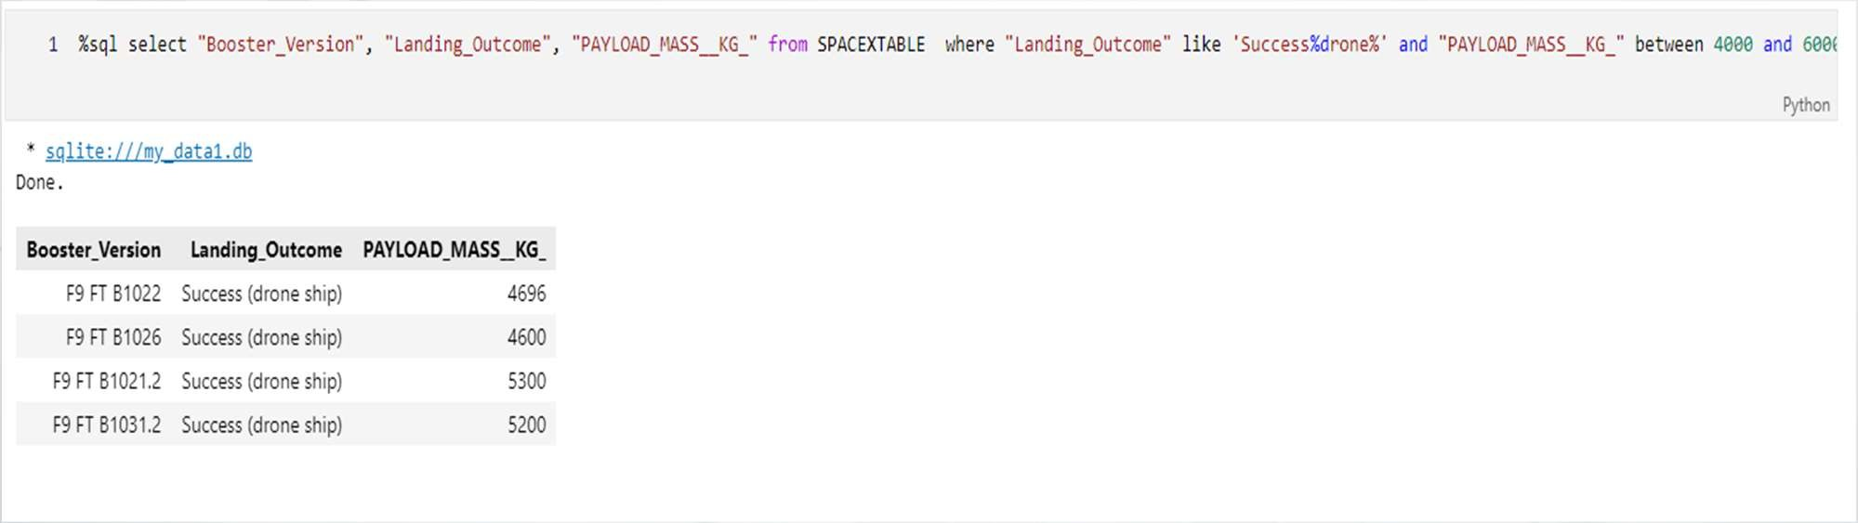
EDA – SQL
The list shows successful drone ship landings for payloads between 4000 and 6000

Slide 34
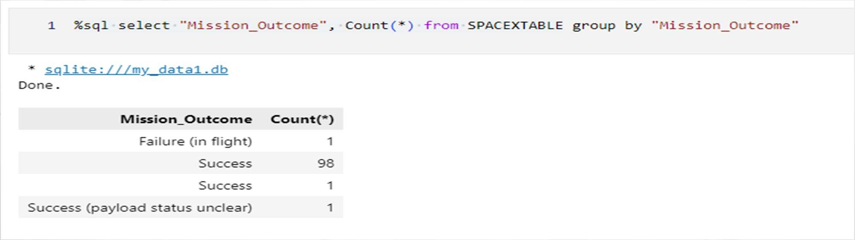
EDA – SQL Total number of success and failures
The list shows the total numbers of successes and failures

Slide 35
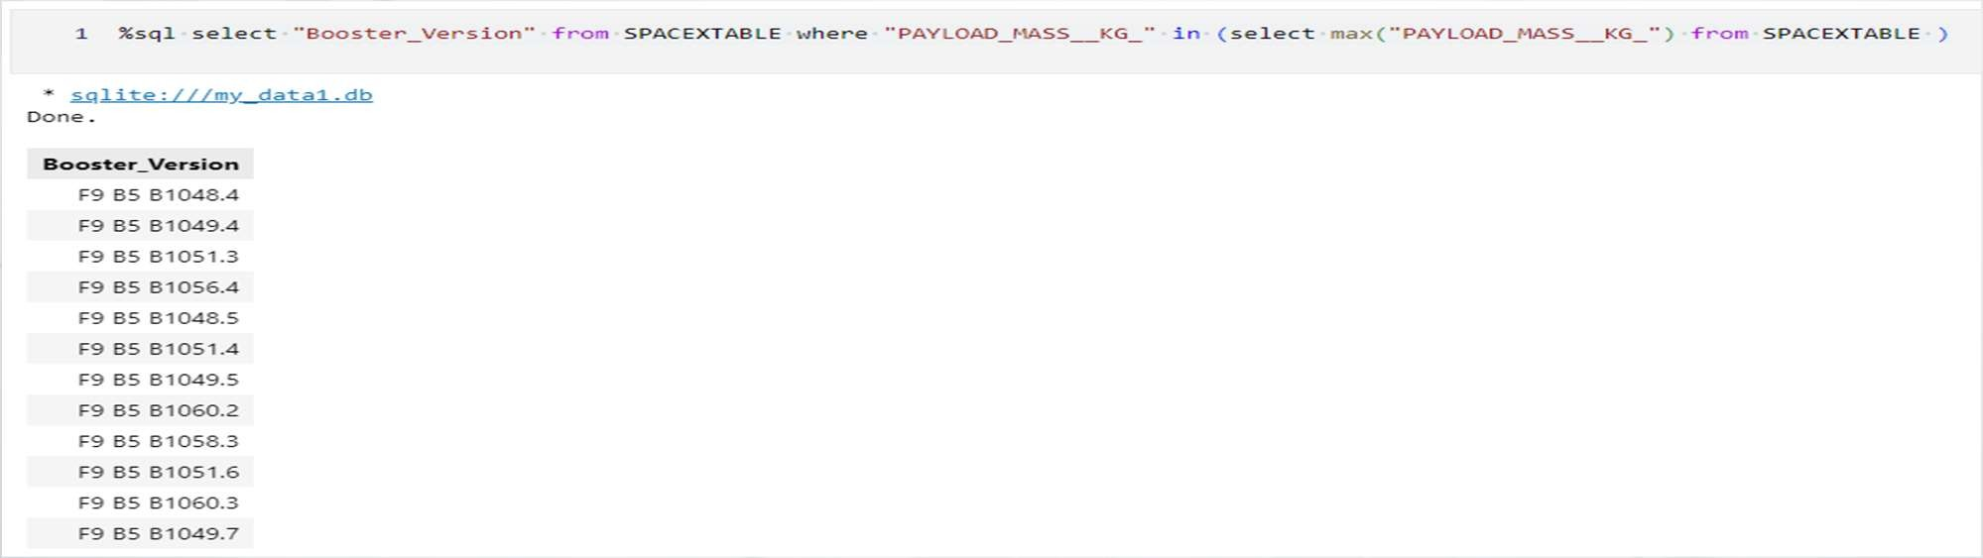
EDA – SQL Boosters with maximum payload
The list shows the booster versions with the maximum payload

Slide 36
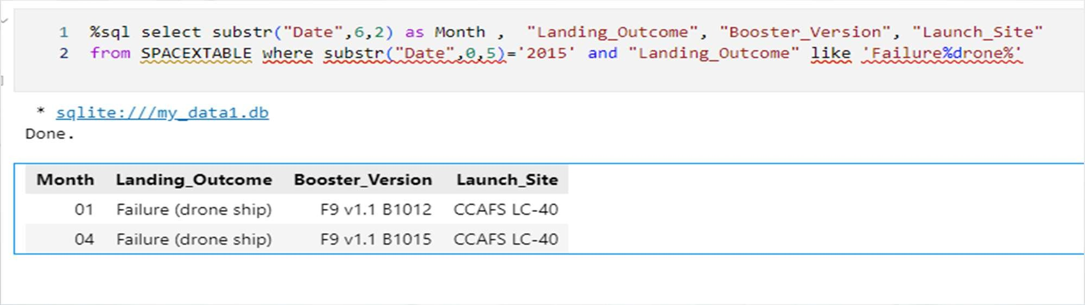
EDA – SQL 2015 drone ship landing failures
The list shows the failed landing outcomes for drone ship, their booster versions, and launch site names for in year 2015

Slide 37
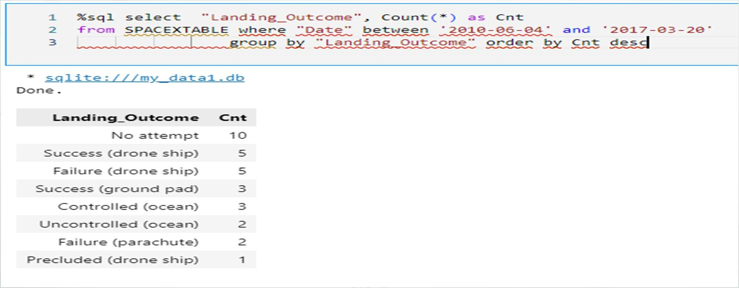
EDA – SQL
Rank Landing Outcomes Between 2010-06-04 and 2017-03-20
The list shows the ranked count of landing outcomes between the date 2010-06-04 and 2017-03-20, in descending order

Slide 38
Launch sites proximities analysis
Section 3

Slide 39
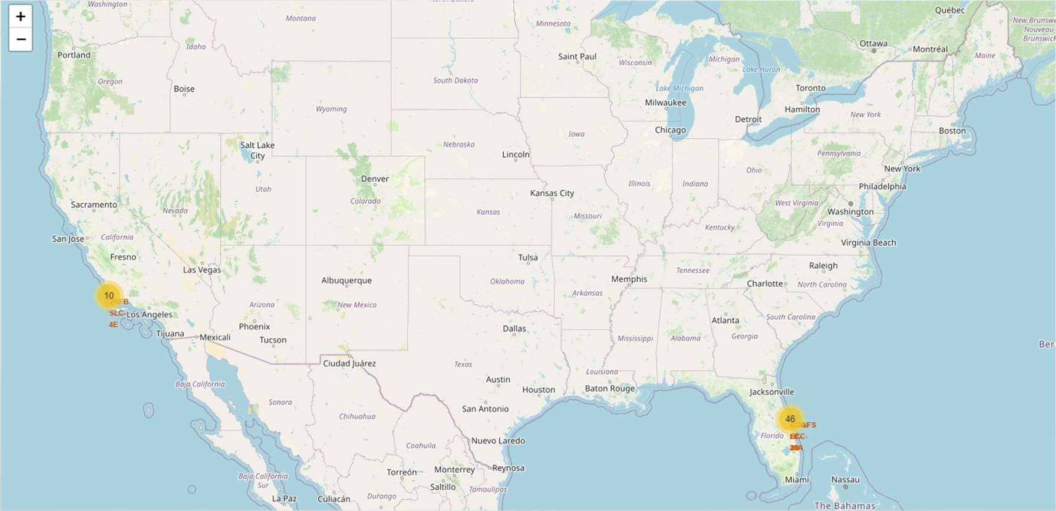
Launch Sites Proximity Analysis
Drawn on a map, we can see that the Launch Site locations are all close to the coastline.
Circles, markers and labels have been added to interactively zoom into detail on the maps

Slide 40
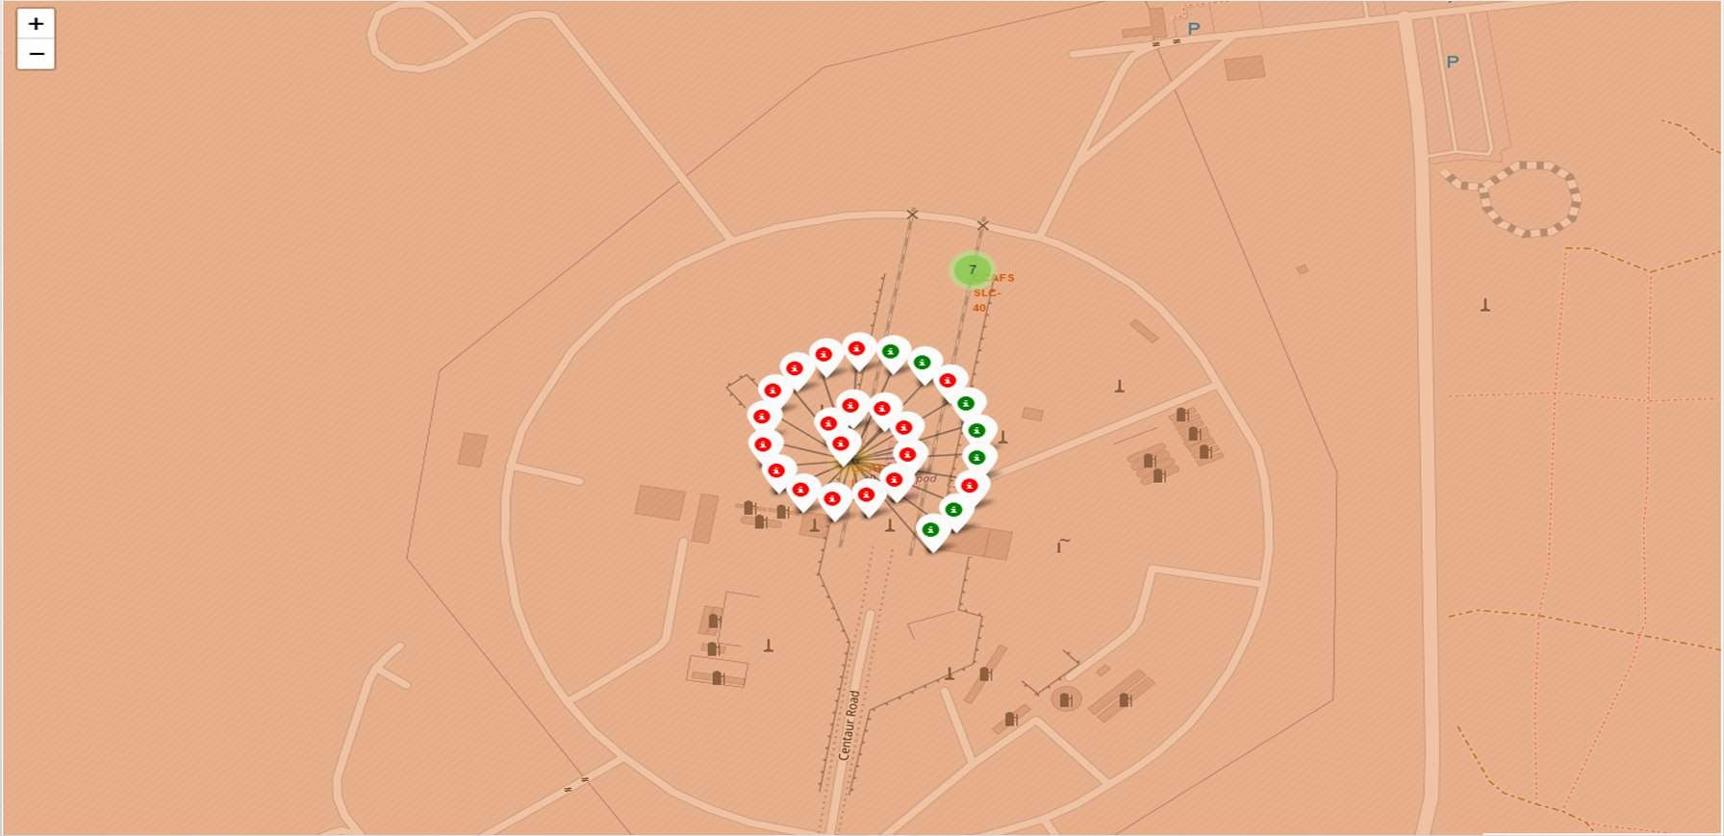
Launch Sites Proximity Analysis – Landing Outcomes
For each landing attempt a marker has been drawn on the map to show the location of the attempt
A red marker shows a failed landing, a green marker shows a success.

Slide 41
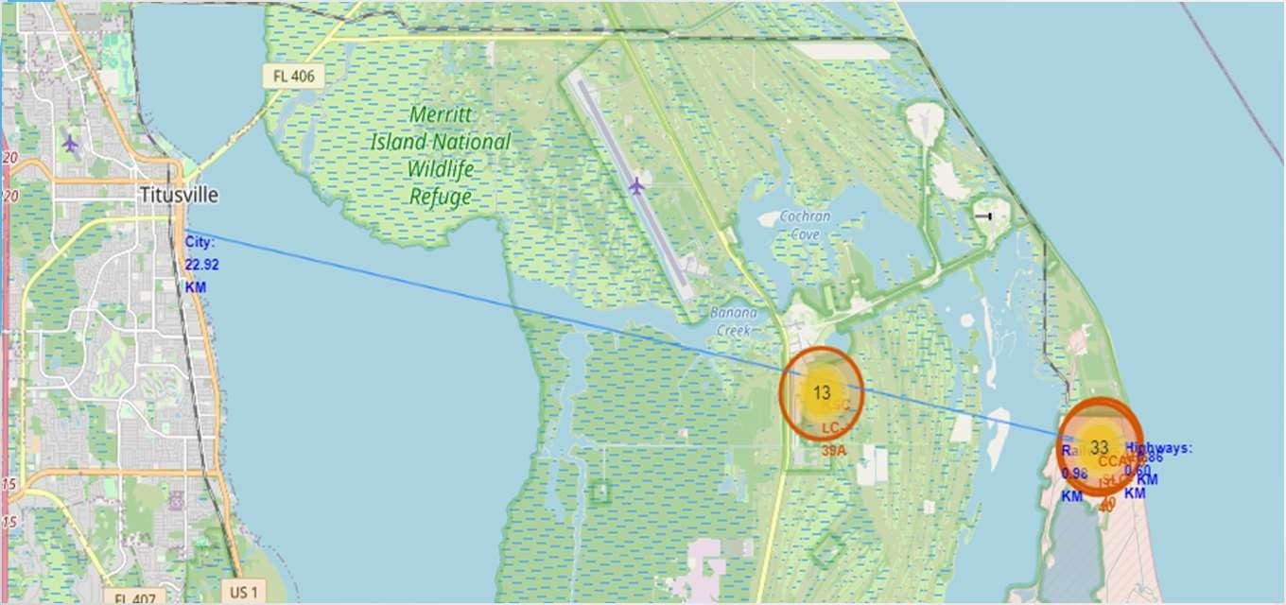
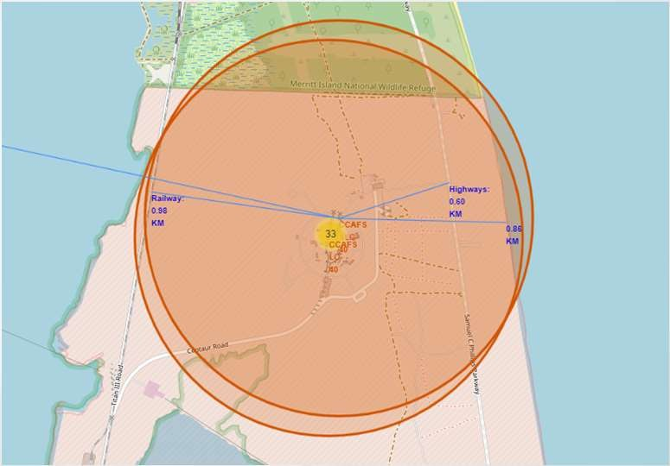
Launch Sites Proximity Analysis – Infrastructure
For a launch site we indicate the proximities to infrastructure such as railway, highway, coastline and calculated and displayed the distance
It shows that a launch site is typically located close to coastline, railway and highway but far away from cities or living space in general.

Slide 42
Build a dashboard with plotly dash
Setion 04

Slide 43
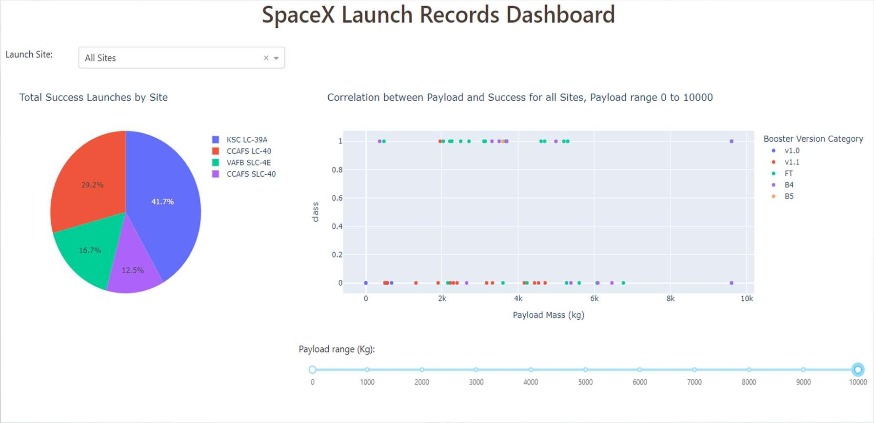
Plotly Dash – Success rates for all Sites
The dashboard allows to filter for Sites and payload range as displayed in the chart titles.
Comparing the success rates, we can see that both KSC LC 39A and CCAFS LC-40 have the better success rates

Slide 44
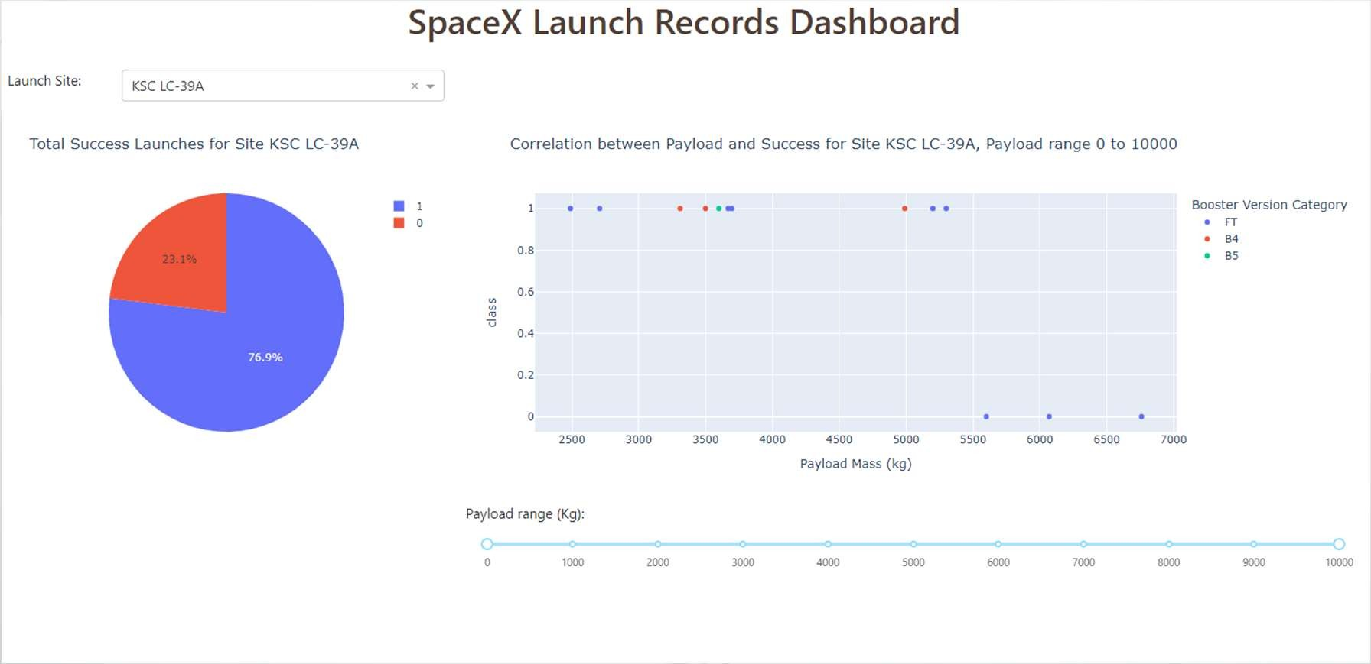
Plotly Dash – Success for KSC LC-39A
Drilling down to KSC LC 39A we can see that the payload has a strong influence on the success for the site.
Heavier payloads cannot be landed successfully here

Slide 45
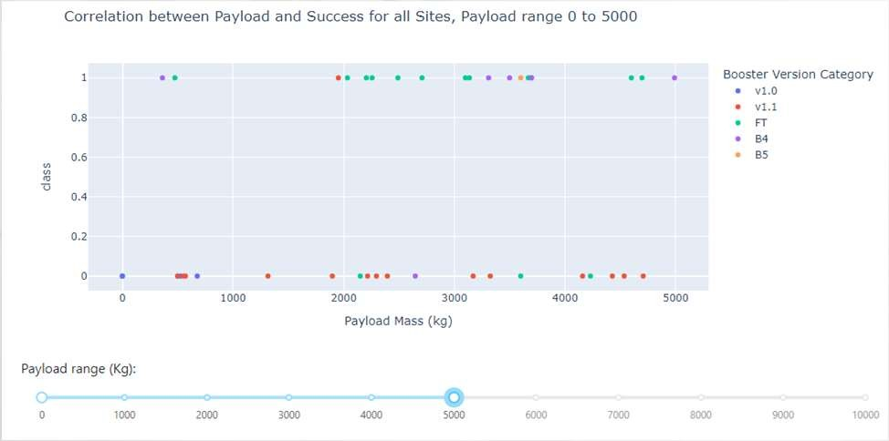
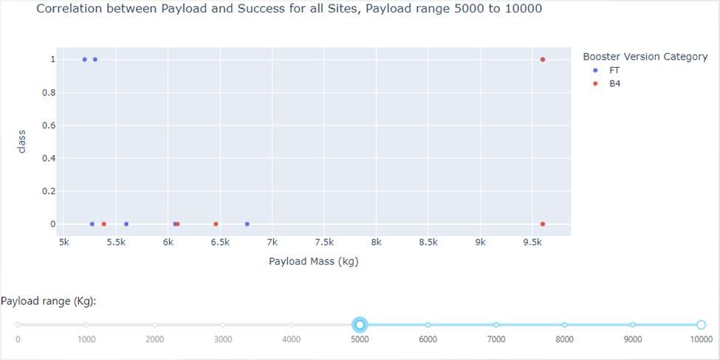
Plotly Dash – Payload and Booster Version
For a payload range from 0-5000 kg we can see a mixed picture
Early Booster versions like v1.1 have a high failure rate
Newer Boosters like B4 and B5 show far better performance but also show some failures
For a payload range of more than 5000 kg we can see predominantly failures
We also see that only two Booster version FT and B4 were used for higher payloads
B4 looks like the preferred option for payloads above 6000 kg
Low Payload High Payload

Slide 46
Predictive analysis (classification)
Section 5

Slide 47
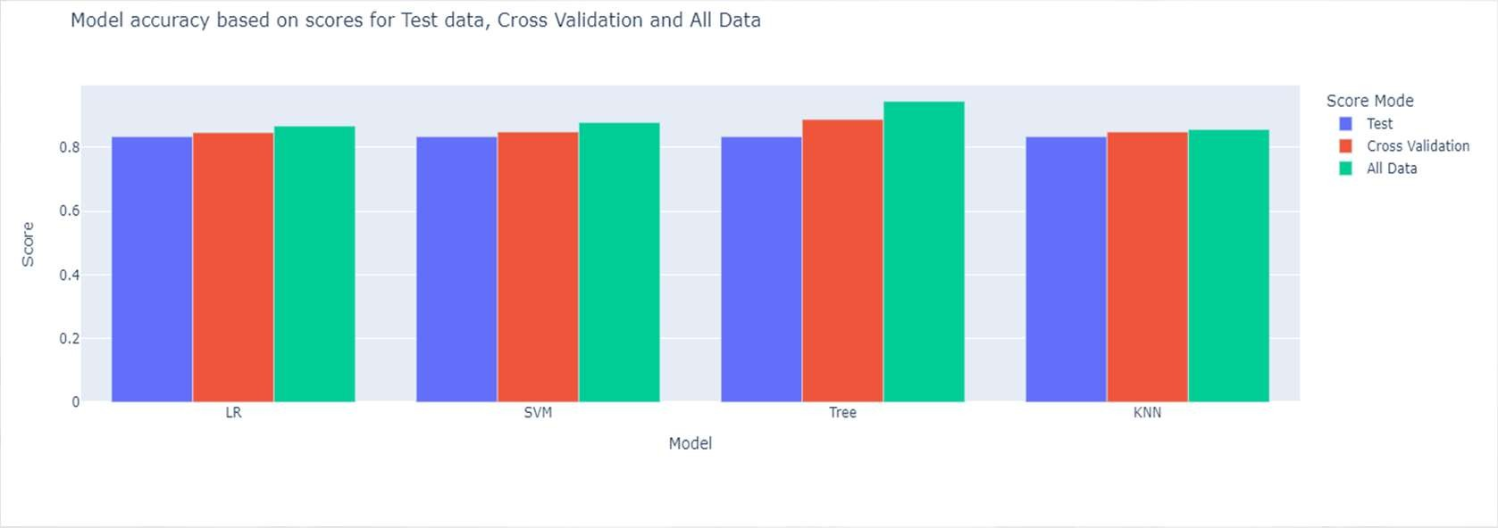
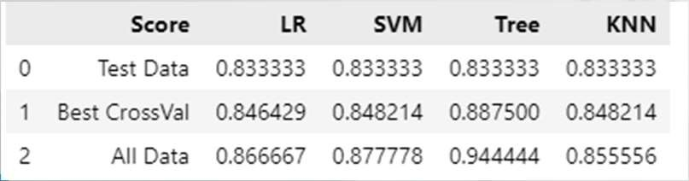
Prediction Analysis – Accuracy Score
The accuracy scores for the four developed models are identical for test data.
If we extend the scoring for the best score achieved during cross validation and the score of the best tuned model for all data, test and training, we can see that the best scoring result is achieved by the Decision Tree model.
This is confirmed by the different Confusion matrix results.

Slide 48
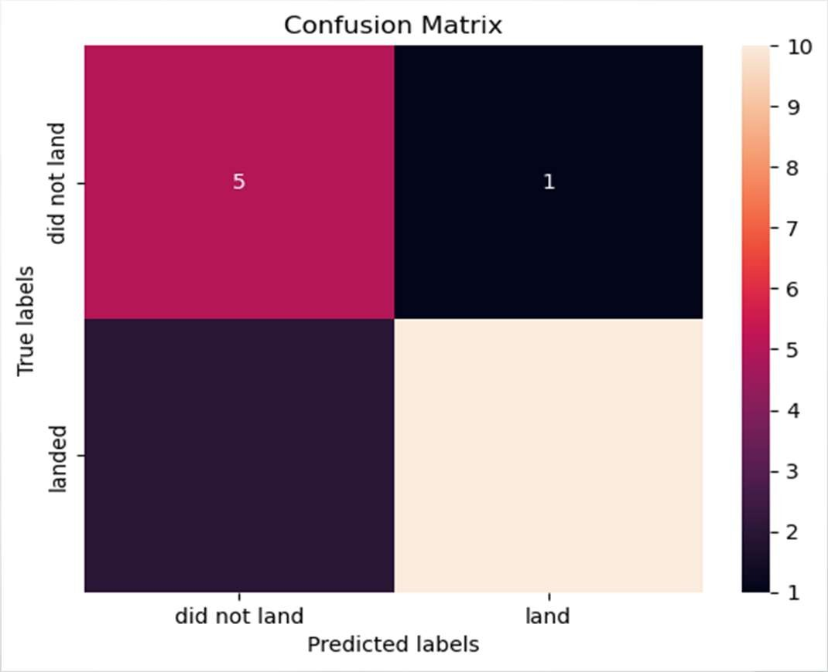
Predictive analysis – Confusion Matrix
The confusion matrix for the best fitted decision tree model, shows good accuracy.
Out of 18 test samples:
  15 are predicted correctly
  1 false positive, predicted as success but did not land
  2 false negative, predicted as failure but did land

Slide 49
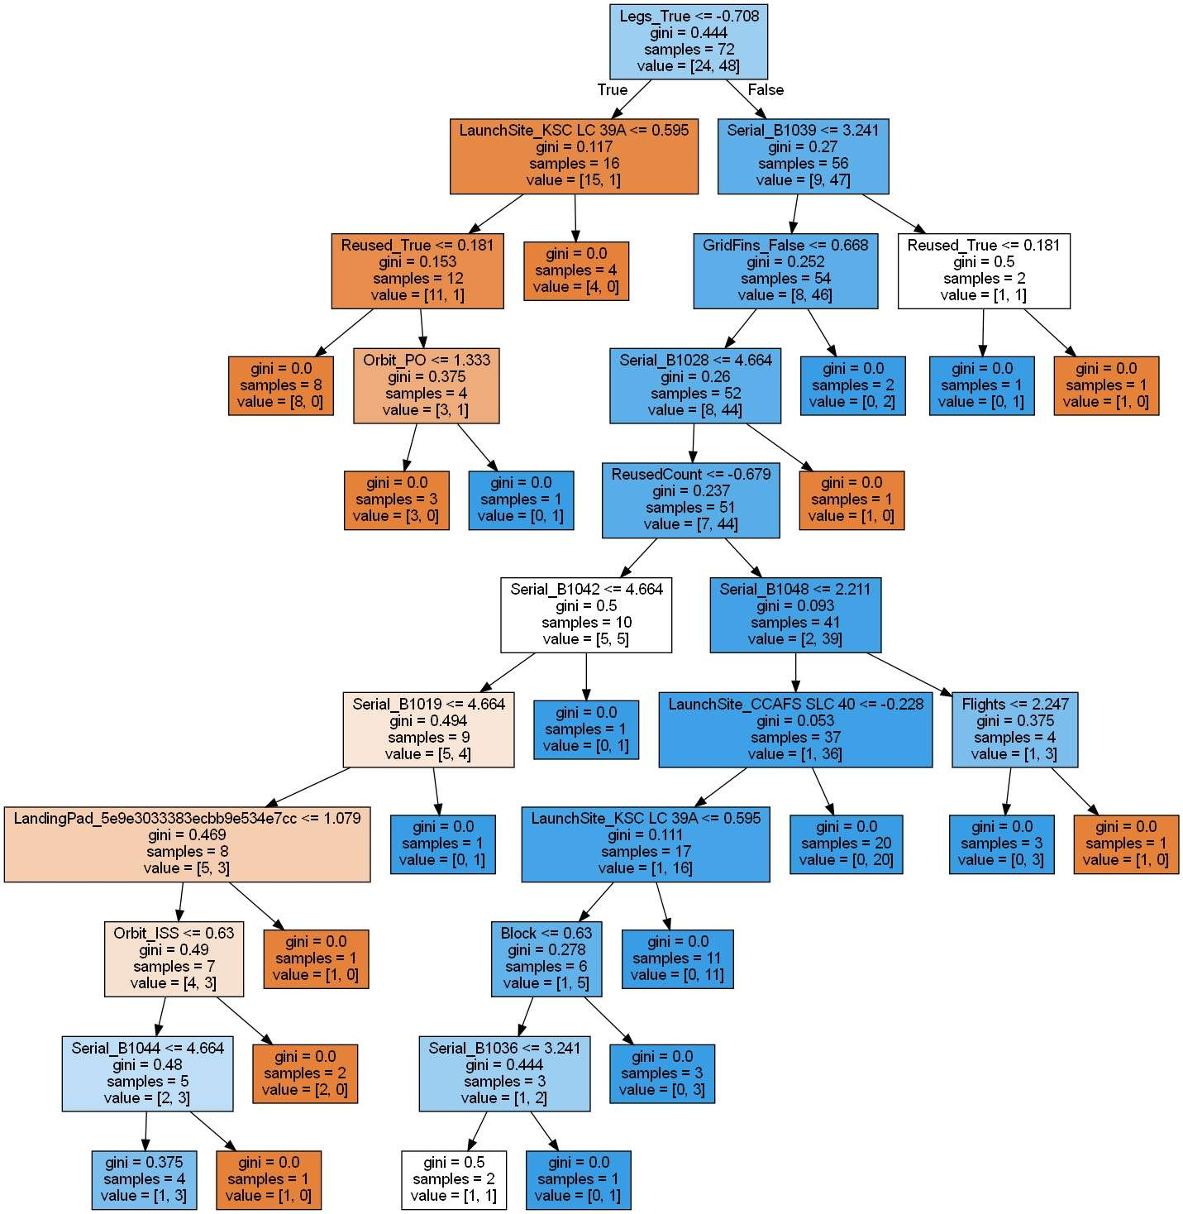
Predictive analysis – The tree model
The decision tree model gives some insight which features were discriminating.
Two technical features were identified for further analysis and potential new insights:
  Legs and
  Grid Fins

Slide 50
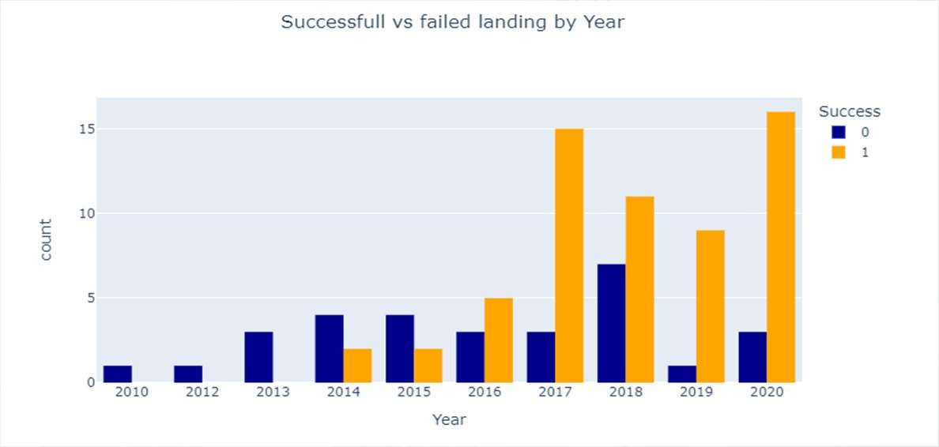
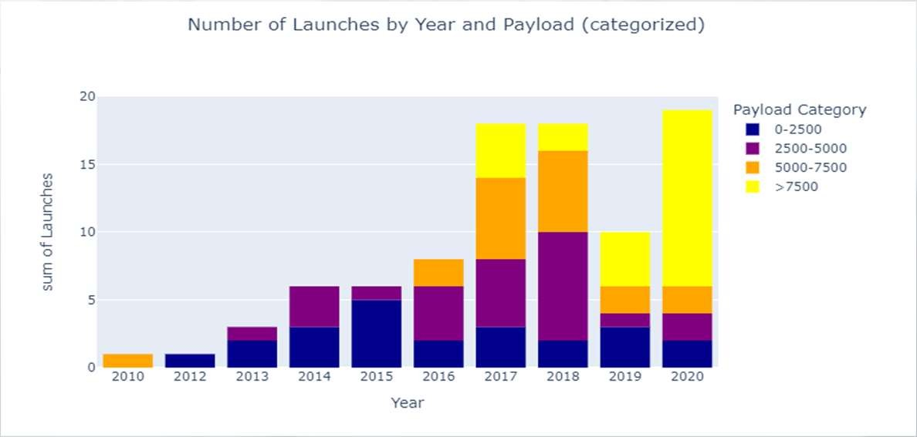
Predictive analysis – Trends
To visualize the trend, we aggregated the data into years and payload categories.
We can see that success rate, and also success count increase over time
The ability to handle larger payloads improved also over the years.
Payloads larger than 7500 kg were first introduced in 2017

Slide 51
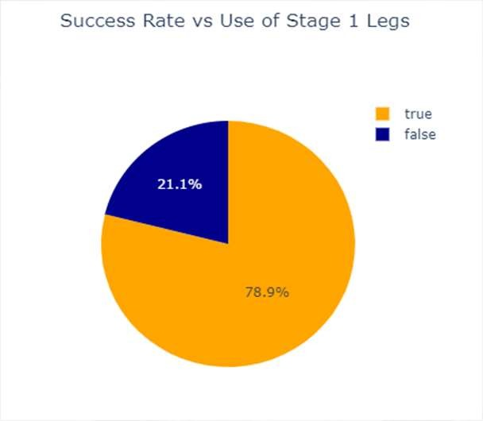
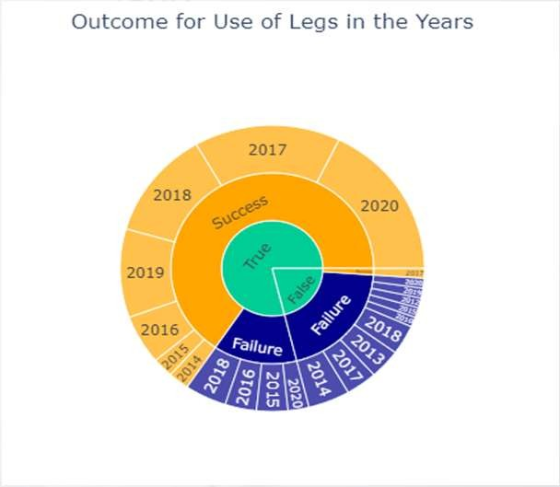
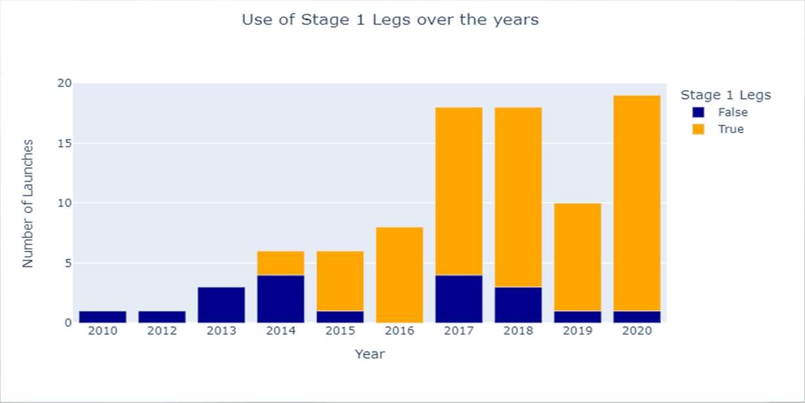
Predictive analysis – Use of Legs for Stage 1
Falcon 9's first stage legs are designed to retract along the side of the rocket and extend outward to facilitate stable landing on solid ground or drone ships after launch. They were first introduced 2014.
We can see that the use of these deployable landing legs has a success rate of 78.9%.
We can also see that they are more often used in later history and that they while not guaranteeing a success are deployed at increasing success rate.

Slide 52
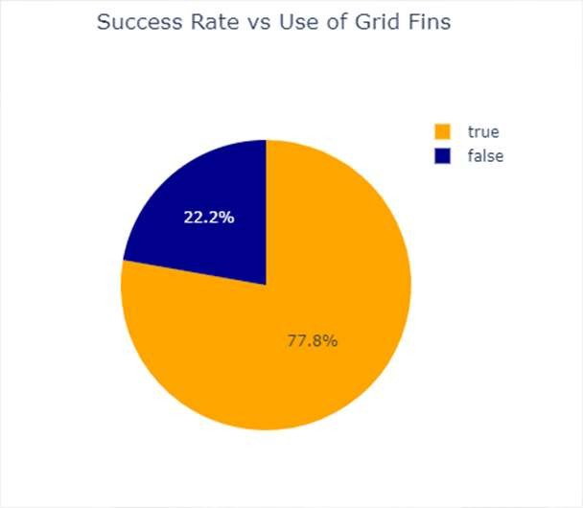
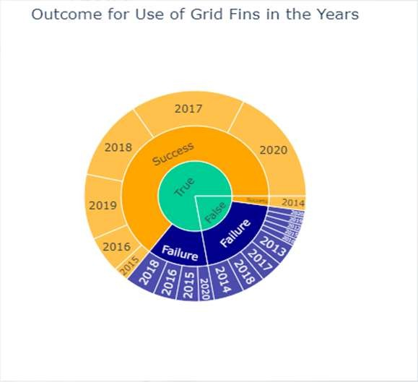
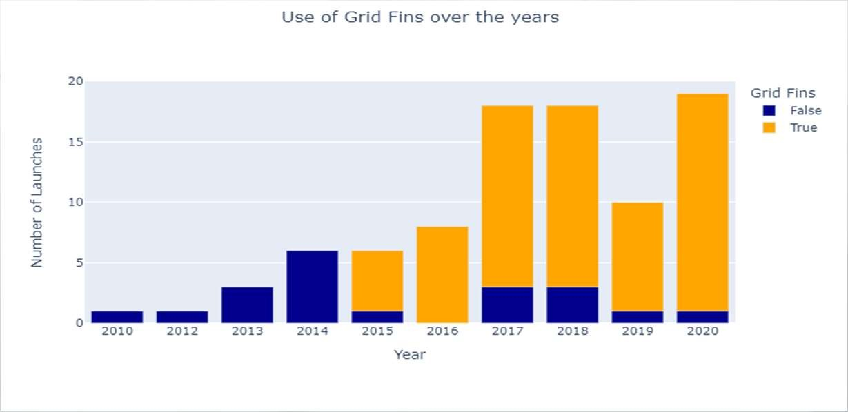
Predictive analysis – Use of Grid Fins
Falcon 9's grid fins deploy during descent to provide precise aerodynamic control for steering and stabilizing the first stage as it returns to Earth. They were first introduced 2015.
We can see that the use of these deployable landing legs has a success rate of 77.8%.
As Stage 1 Legs they are more frequent used in later history. They do not guarantee a success but are deployed with increasing success rate.

Slide 53
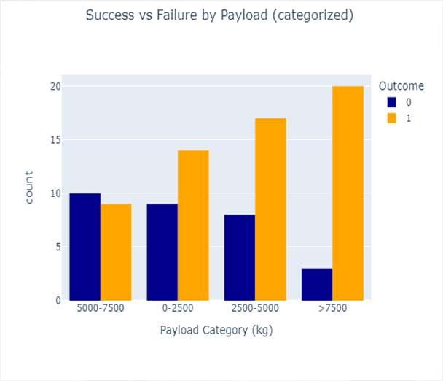
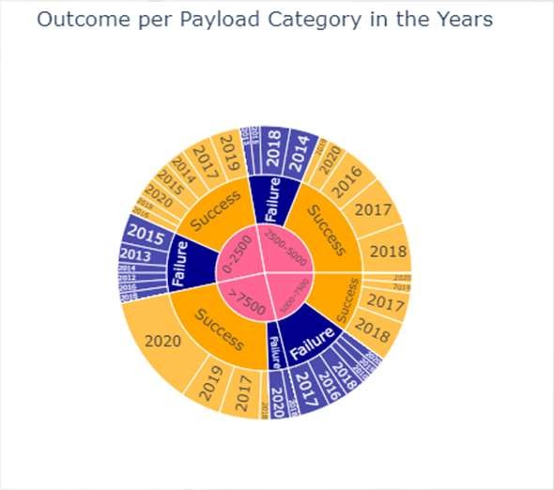

Predictive analysis – Payloads
Payload seem not to have a decisive impact on the success if we analyse the data aggregated in categories.
Higher payloads, later introduced in the launches, perform not worse than lighter payloads in an annual comparison
The sunburst chart shows as example perfect success rates for the high payload category in the years 2019 and 2017.

Slide 54
Conclusions
The available data shows that the success rate for the last year of observations reached a range of more than 80% which explains the cost savings through reuse of the Falcon 9 first stage.
We can see a clear positive trend in the success rate of first stage landings for the Falcon 9 over the years.
Technological advancements like Grid Fins and landing Legs contributed to the improvements. Certainly, experience in launching and landing support also the trend and indicate sustained and potentially increased future cost advantages for SpaceX.
With the derived Decision Tree model, we can predict future landing outcomes with an accuracy of more than 80%.
The model has to be continuously adjusted to take future outcomes and changes in technology into consideration.

